Slide 1
Mixed Effects Models within an Artificial Neural Network (ANN) framework
JKUAT TEAM

Slide 2
Objectives
To develop a Mixed Effects Model within an Artificial Neural Network (ANN) Model.
To apply the developed model to quantify the relationship between UHC and GDP.

Slide 3
The Model
Y = m(x,Q) + e
m(x,Q) … mean Function
e ---- Error term

Slide 4
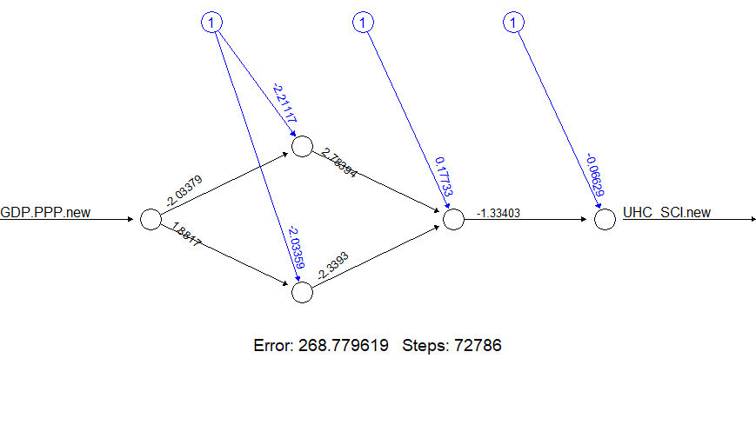
Procedure
Step 1. Initial Fixed Effects Model
Train an artificial neural network to get initial predictions, ignoring the grouping structure.

Slide 5
Procedure
Step 2. Estimate Residuals
Calculate the residuals from the initial ANN model.
Step 3. Model Random Effects
Fit a standard (parametric) mixed-effects model to the residuals using a random-effects structure. This estimates the variance attributable to each group (Country).

Slide 6
Procedure
Step 4. Adjust Target Variable
Update the original target variable by removing the estimated random effects.
Step 5: Re-train ANN
Re-train the neural network using the adjusted target variable.
Step 6. Iterate
Repeat steps 2 to 5 until the model converges on stable estimates for both the fixed (ANN) and random effects.

Slide 7
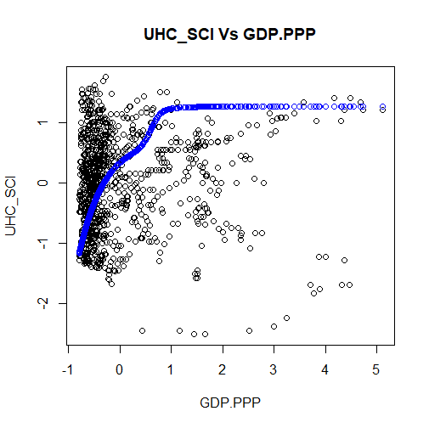
OUTPUT

Slide 8
Interpretation
The suggested model is able to quantify the expected positive relationship between GDP.PPP and UHC_SCI.
While higher GDP enables better care, UHC is not solely dependent on wealth. A full model will be developed based on the available data.

